Slide 1
© 2018 Cengage Learning®. May not be scanned, copied or duplicated, or posted to a publicly accessible website, in whole or in part.

Slide 2
Channels of Distribution
10
© 2018 Cengage Learning.® May not be scanned, copied or duplicated, or posted to a publicly accessible website, in whole or in part.

Slide 3
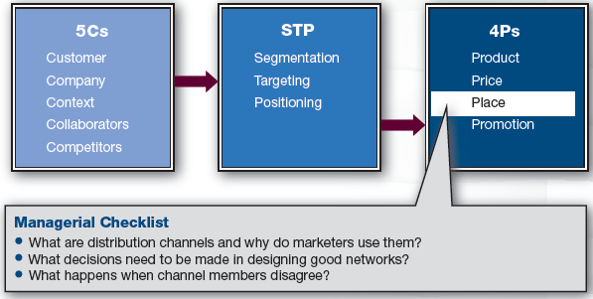
Marketing Framework

Slide 4
Discussion Questions #1
Apple introduced the Apple retail store in 2001 when it had less than 3% of the computer market—prior to its introduction of the iPod. Previously, Apple computers were sold through local computer retailers.
What do you think prompted the idea for Apple’s new retail strategy?
What were the risks associated with this strategy?

Slide 5
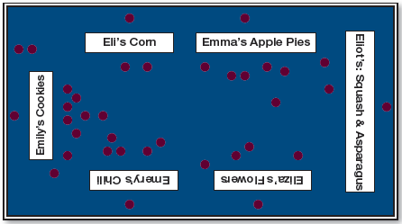
Place
The market realigns discrepancies between buyers and sellers
Sellers have large quantities; Buyers want a few
Breaking bulk
Making goods available in smaller batches

Slide 6
Distribution Channels
Distribution channel
A network of firms that are interconnected in their quest to provide sellers a means of infusing the marketplace with their goods, and buyers a means of purchasing those goods
The goal is to do this efficiently and profitably
Channel members include
Manufacturers, wholesalers, retailers, consumers, etc.

Slide 7
Functions of a Channel
Activities that are
Customer-oriented (e.g., ordering)
Product-oriented (e.g., storage)
Marketing-centric (e.g., promotion)
Logistics
Coordinating flow of goods, services, and information throughout channel

Slide 8
Channel Tension
All channel functions must be done by someone, the question is …
What is the most effective and efficient way to distribute the product?
Tension in channels can be created by each channel member
Does member provide more benefit than cost?
The make-or-buy decision

Slide 9
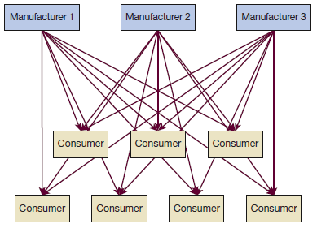
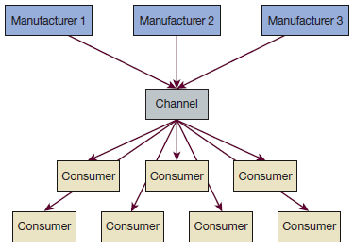
Channel Questions #1
Which of these is more efficient? Why?

Slide 10
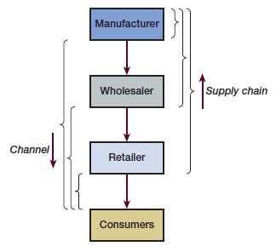
Channels and Supply Chains
Supply chain
Upstream partners
Channel members
Downstream partners

Slide 11
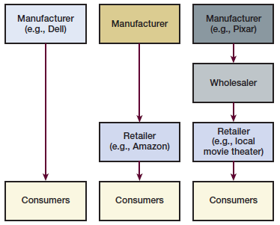
Channel Questions #2
Who is in Amazon’s supply chain?
Who is in Pixar’s channel?
How is Dell’s distribution different from the others?

Slide 12
The What, Why, & How of Channels
The “what” of channels
Network of suppliers and providers
The “why” of channels
Effectiveness and efficiency
The “how” of channels
Designing effective and efficient channels

Slide 13
How to Design Channels (slide 1 of 4)
Intensive distribution: widely distributed
Drugstores, supermarkets, discount stores, convenience stores, etc.
Usually for simple, inexpensive, easily transported products
e.g., Snack food, shampoo, newspapers
Pull strategy: promote directly to end consumers to pull through channel

Slide 14
How to Design Channels (slide 2 of 4)
Selective distribution: limited distribution
Usually for complex and/or expensive products that require assistance
e.g., Most cars, computers, appliances
Push strategy: promote to distribution partners to push goods to consumer
Manufacturer has more control due to fewer relationships to manage

Slide 15
How to Design Channels (slide 3 of 4)
Exclusive distribution: extremely selective
e.g., Ferrari and Rolex
Manufacturers have the most control
May become monopolistic

Slide 16
How to Design Channels (slide 4 of 4)
How much distribution?
Design needs to be consistent with other marketing elements
Wide distribution
Usually goes with heavy promotion, lower prices, and average or lower-quality products
Exclusive distribution
Usually goes with less promotion, higher prices, and higher-quality products

Slide 17
Push vs. Pull Strategies (slide 1 of 2)
Push strategy
Incentives are offered to distribution partners to push products through the channel
Pull strategy
Incentives are offered to consumers to pull products through the channel

Slide 18
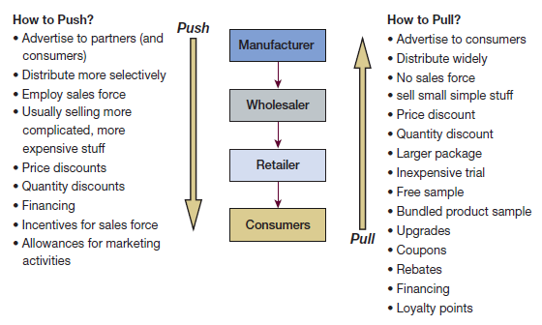
Push vs. Pull Strategies (slide 2 of 2)

Slide 19
Power and Conflict in Channels
Conflict arises in distribution channels
Some conflict can be healthy
Some conflict can end a partnership
Power
Power is usually defined by size
Power can be used to win conflict
Exerting power over distribution partners can lead to resentment and lack of cooperation

Slide 20
Transaction Cost Analysis (TCA)
Model that considers channel members’ production costs & governance costs
Goal is to minimize both costs
Production cost
Cost of producing/bringing product to market
Governance cost
Cost involved with relational issues incurred by coordinating enterprise and controlling one’s partners

Slide 21
Transaction Value Analysis
Perspective that emphasizes the benefits a company brings to its partners
Goes beyond cost reductions
Uses human relationship terms
Communication enhances trust
Trust is the willingness and ability to deliver on promises

Slide 22
Ways to Resolve Conflict
Communicate
Exchange personnel
Sponsor joint research projects
Mediation
Negotiate through a third party that determines the two parties’ utility functions
Arbitration
The third party makes a binding decision for the two parties

Slide 23
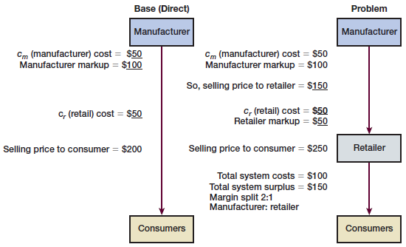
Revenue Sharing (slide 1 of 2)
Double marginalization: the problem
The manufacturer wants a markup
The retailer wants a second markup

Slide 24
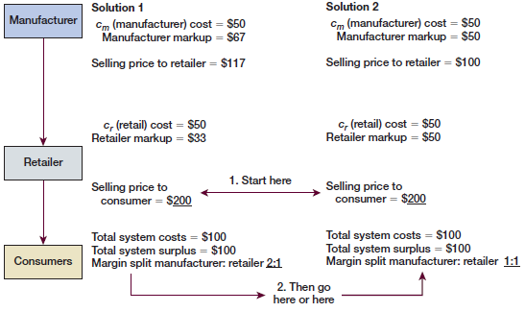
Revenue Sharing (slide 2 of 2)
Double marginalization: solutions

Slide 25
Discussion Question #2
Why wouldn’t the manufacturer just avoid the double marginalization problem entirely and go directly to the consumer?

Slide 26
Integration (slide 1 of 3)
All functions within a channel need to be completed
Revisit make-or-buy decision
Make: complete a function yourself
Buy: outsource a function

Slide 27
Integration (slide 2 of 3)
Vertical integration
Moving backward or forward in a channel
Forward integration
Moving forward in a distribution channel
e.g., Manufacturer opens its own retail stores
Backward integration
Moving backward in a distribution channel
e.g., Manufacturer controls raw materials or retailer sets up private label

Slide 28
Integration (slide 3 of 3)
Private label
Type of backward integration
Advantages
Gives retailer negotiating power with manufacturers
Offers significant margins
Helps differentiate retailer from other retailers
e.g., Great Value oatmeal is only at Walmart

Slide 29
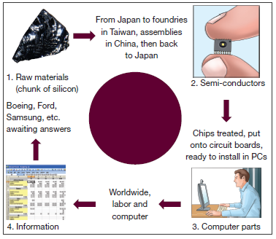
Global Channels
Channels can be complicated

Slide 30
Discussion Questions #3
How might Anheuser-Busch engage in forward integration?
How might Google engage in backward integration?

Slide 31
Retailing & Retail Classifications
Retailers have been gaining power and momentum over the past 10–20 years
Retailers are classified by ownership, level of service, and product assortment
Management’s level of ownership
Independent retailers
Branded store chains
Franchises

Slide 32
Retailing Classifications
Level of service provided
Usually related to price points
Product assortment carried
Specialty: carry depth not much breadth
e.g., Toy stores
General merchandise: carry breadth but not much depth
e.g., Department stores

Slide 33
Retailing Employees
Retail employees are important
Connect the retailer and its customers
Retailers should hire selectively, train well, and pay fairly
Dissatisfied employees can lead to dissatisfied customers and employee turnover
Employee turnover leads to new associates who cause further customer dissatisfaction

Slide 34
Retailing Operations
Retailing is a service
Retailers should flowchart operations
Front-stage: elements customers see
Backstage: elements customers do not see
Must be run efficiently to support front-stage
The goal is to create effective and efficient processes
Self-service is a way to streamline

Slide 35
Retailing Location
Location is important
Determine appropriate success factors for your specific business; analyze locations to pick ideal sites
e.g., Population densities, income and social class distributions, median ages, household composition

Slide 36
Retailing Growth Strategies
Provide additional services
Target additional segments
Open multiple stores
Expand internationally
e.g., Exporting, joint ventures, direct foreign investment, and license agreements
Global outsourcing
e.g., India & technology, China & manufacturing

Slide 37
Franchising
Unique format of multisite expansion
Company can retain some control without complete ownership or capital expenditure
Benefits
Franchisor: receives capital, scales of economy, committed people, less risk, can focus on core functions
Franchisee: well-known brand and some market awareness, supplier relationships, templates for training, central support

Slide 38
Types of Franchising
Product franchising
Supplier authorizes a distributor in a territory to carry its products, use its brand name, benefit from its advertising, etc.
e.g., Ford dealers, Coca-Cola bottlers
Business format franchising
Company offers a proven system to conduct business, marketing support, brand name, advertising, etc., to the franchisee
e.g., McDonald’s, Holiday Inn

Slide 39
E-Commerce
The Internet is an important channel
Online retail sales are about $180 billion, growing about 10% a year
Still only 11% of total retail sales
Customers are younger and more affluent
Customer characteristics are changing to match customers in general markets
United States dominates but not by much

Slide 40
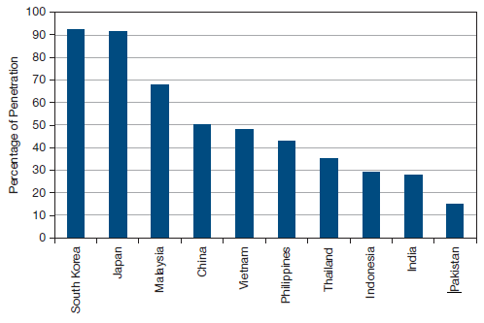
Asian Internet Penetration Percentages

Slide 41
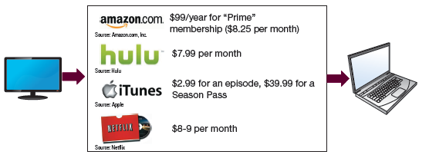
Discussion Question #4
How do you see the future for the distribution of entertainment programs?

Slide 42
Catalog Sales
Top 10 catalogers are B2B companies
e.g., Dell, Staples, etc.
80 of the top 100 catalogers continue to see sales growth
Internet is well-suited for a search while catalogs still dominate browsing
Catalogs often complement not compete with Internet

Slide 43
Sales Force (slide 1 of 3)
Utilized extensively with a push strategy
Important with undifferentiated products
Issues
How many?
How to compensate them?
Usually salary plus bonuses
Tie compensation to performance evaluation
Sales force evaluation factors
e.g., Sales, time with clients, expertise

Slide 44
Sales Force (slide 2 of 3)
Sales force size
Estimate workload
100,000 stores
12 visits each per year for 30 minutes
50 weeks per year × 40 hours a week = 2,000 hours
500 of these hours will be spent on travel and administrative duties
(100,000 accounts × 12 visits per year × 0.5 hour)/1,500 hours = 400 salespeople

Slide 45
Sales Force (slide 3 of 3)
B2B customers’ biggest complaints about salespeople
The salesperson isn’t following my company’s buying process
They don’t listen to my needs
They didn’t bother to follow up

Slide 46
Discussion Questions #5
What criteria would you utilize to evaluate a car salesperson?
How would you tie compensation to this evaluation?

Slide 47
Integrated Marketing Channels
As the number of channels proliferates, increasing care must be taken to coordinate and integrate across them
Companies must understand customer behavior in order to design effective distribution channels and to allocate resources across channel options
Know your customer!

Slide 48
Managerial Recap (slide 1 of 2)
Distribution channels are the link from the manufacturer to the customer
Numerous thoughtful decisions must be made in designing channels

Slide 49
Managerial Recap (slide 2 of 2)
Channel entities are independent yet interdependent organizations; thus, conflicts may arise
Conflicts are best addressed by employing good communication and trust, revenue sharing, or greater vertical integration

